Slide 1

School of Computing Science and Engineering
Course Code: BCS01T1004 Course Name: Computer Workshop
Unit - 4
Topic: Installation of Windows 7 (Case Study)

Slide 2
MS Windows Versions
Operating system boot by
1.Flash Drive (Bootable Pen Drive)
2. Bootable CD/DVD
3.Hard Disk

Slide 3
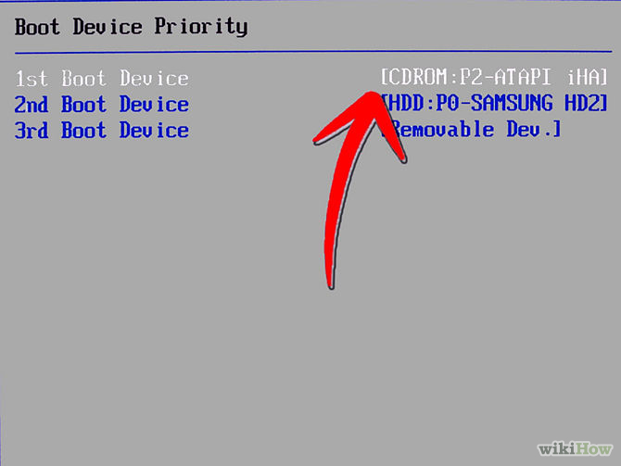
MS Windows Versions
Turn your computer on and then press Del or F2 (depend on your computer’s mainboard) to enter the system BIOS

Slide 4
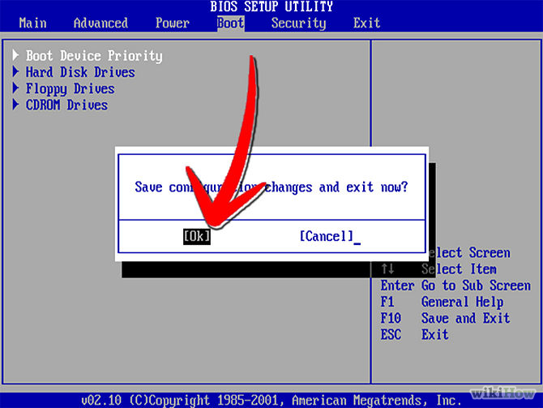
MS Windows Versions
Go to Boot menu and choose Boot From CD/DVD.

Slide 5
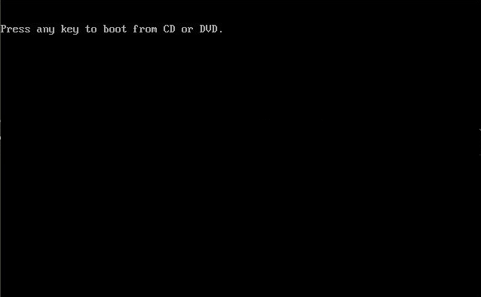
MS Windows Versions
Load your Windows 7 DVD and boot it. It will now load the setup files.

Slide 6
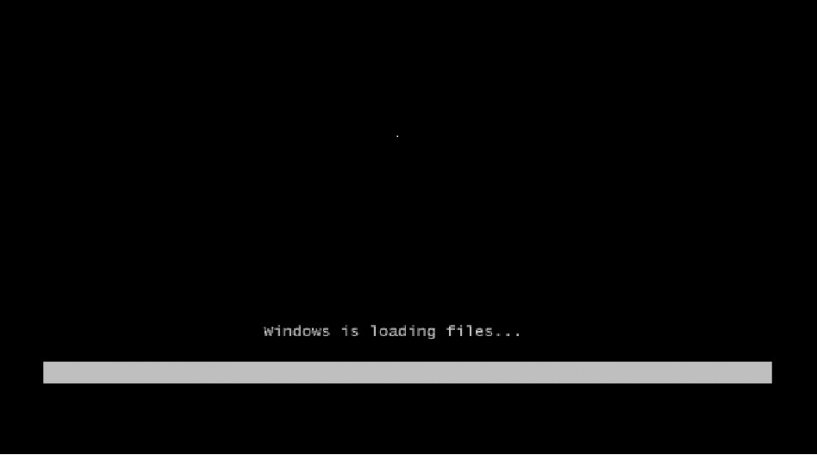
Loading process

Slide 7
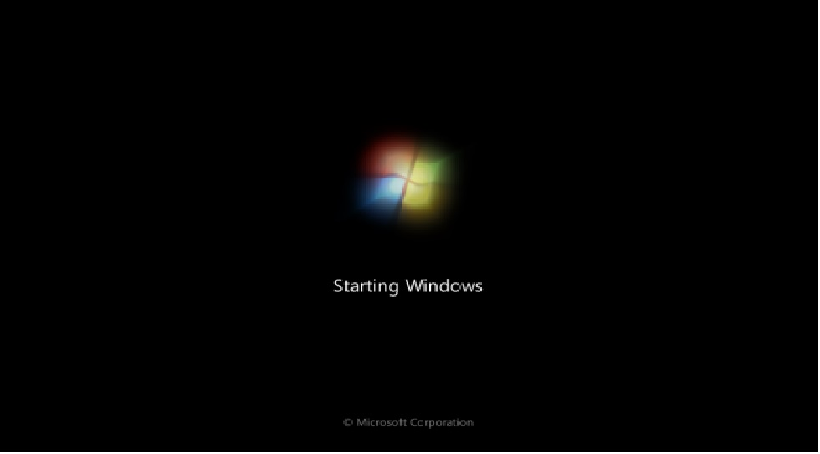
Booting process is in progress

Slide 8
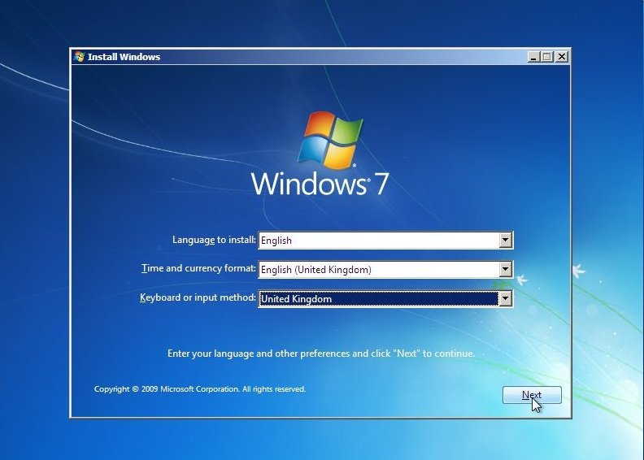
Select your language, time & currency format, keyboard or input method and click Next.
MS Windows Versions

Slide 9
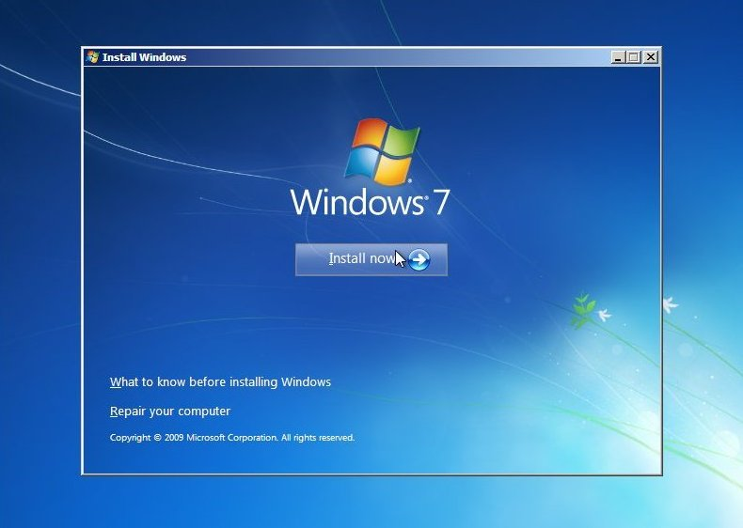
Click Install now.
MS Windows Versions

Slide 10
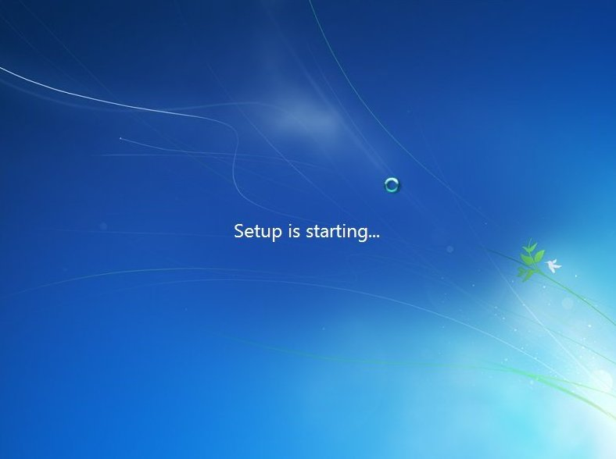
MS Windows Versions

Slide 11
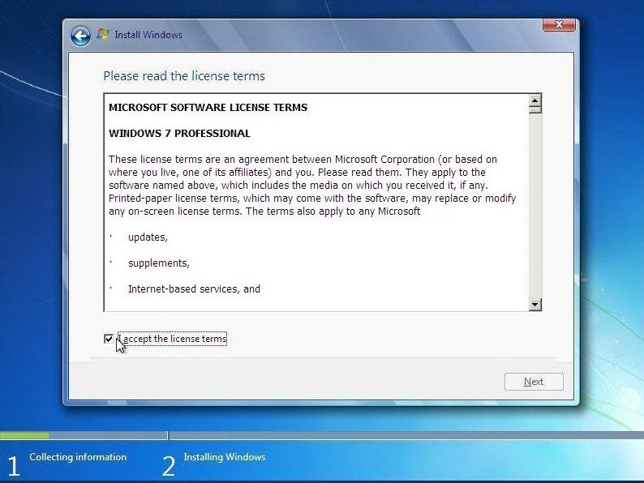
MS Windows Versions
Check I accept the license terms and click Next.

Slide 12
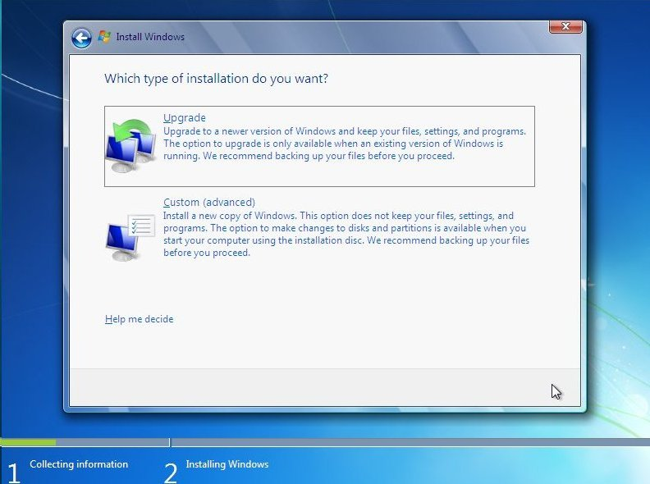
MS Windows Versions
Click Upgrade if you already have a previous Windows version or Custom (advanced) if you don’t have a previous Windows version or want to install a fresh copy of Windows 7.

Slide 13
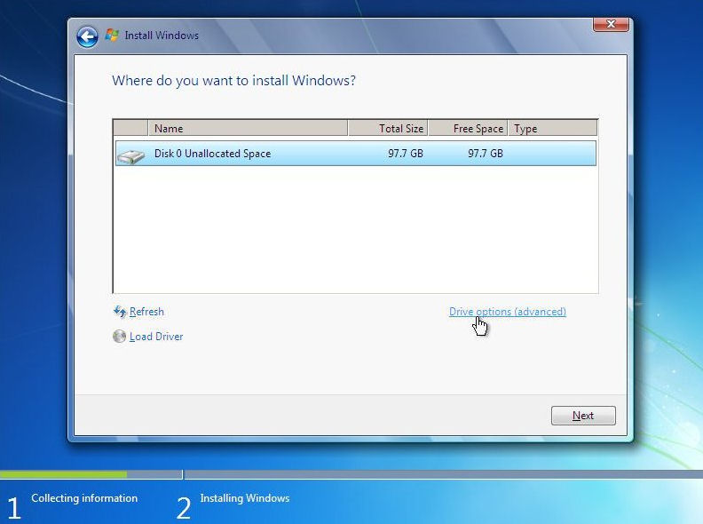
MS Windows Versions
Select the drive where you want to install Windows 7 and click Next. If you want to make any partitions, click Drive options (advanced), make the partitions and then click Next.

Slide 14
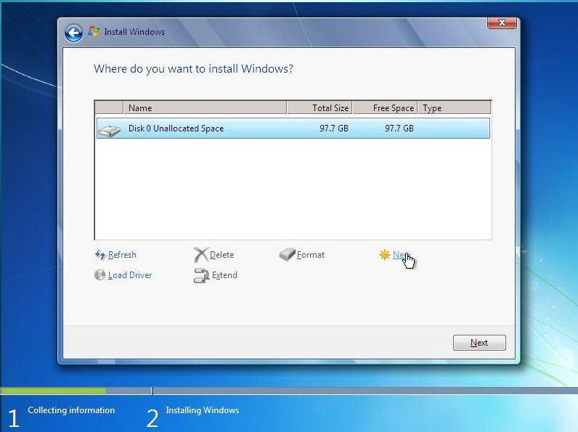
MS Windows Versions

Slide 15
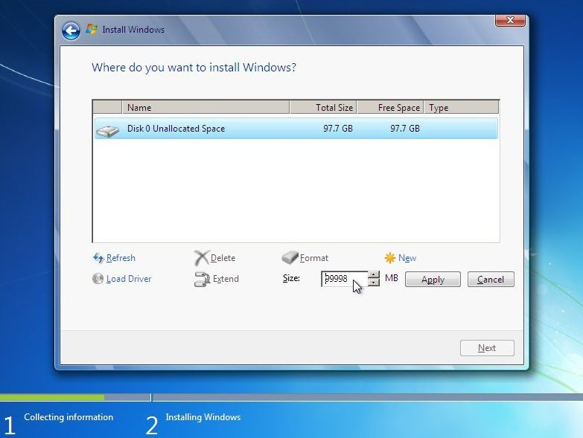
MS Windows Versions

Slide 16
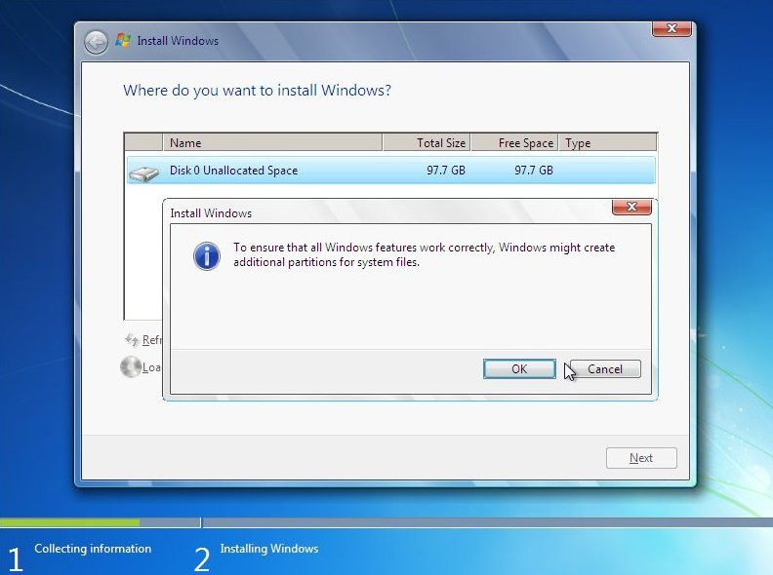
MS Windows Versions
Drive Options Menu: Windows warns that it may need to create a few partitions for the system, Click "OK" to continue.

Slide 17
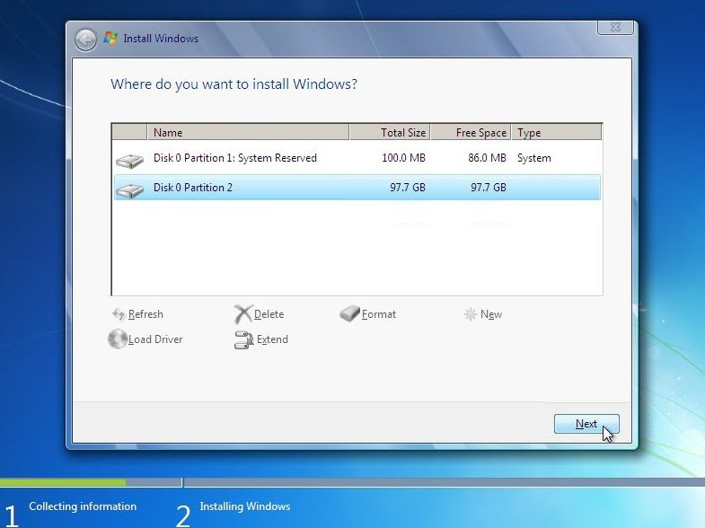
MS Windows Versions

Slide 18
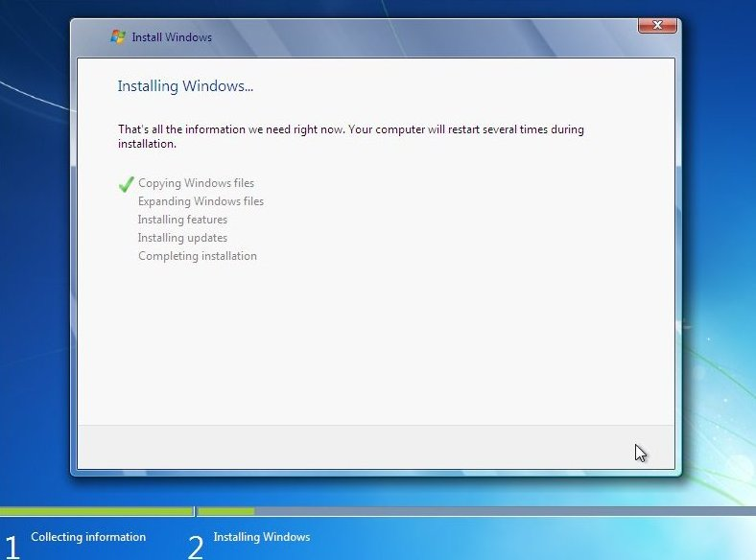
MS Windows Versions
It will now start installing Windows 7. The first step, (i.e. Copying Windows files) was already done when you booted the Windows 7 DVD so it will complete instantly.

Slide 19
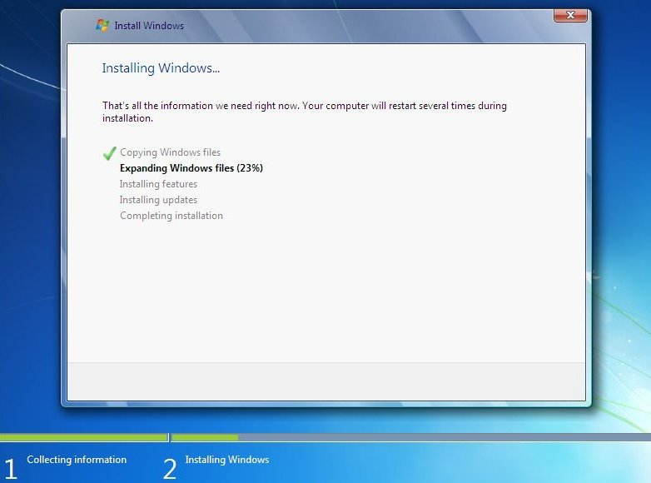
MS Windows Versions
After completing the first step, it will expand (decompress) the files that it had copied.

Slide 20
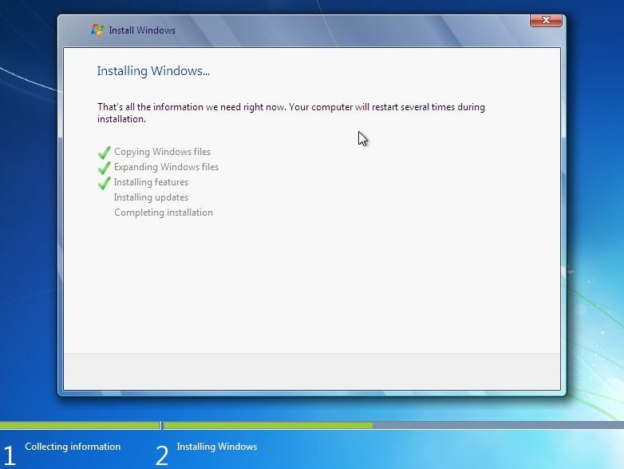
MS Windows Versions

Slide 21

MS Windows Versions

Slide 22
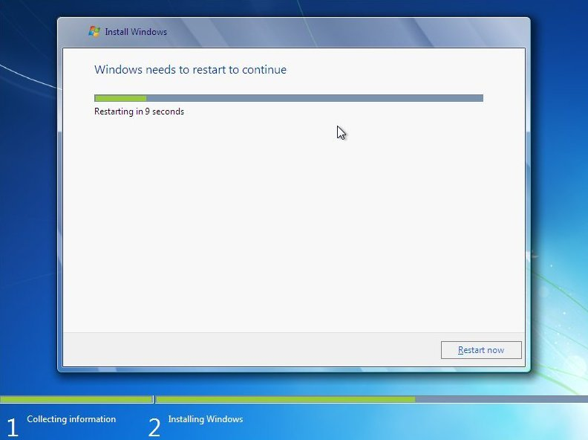
MS Windows Versions
After that it will automatically restart after 15 seconds and continue the setup. You can also click Restart now to restart without any delays.

Slide 23
MS Windows Versions
After installation, Please do not press key this time

Slide 24
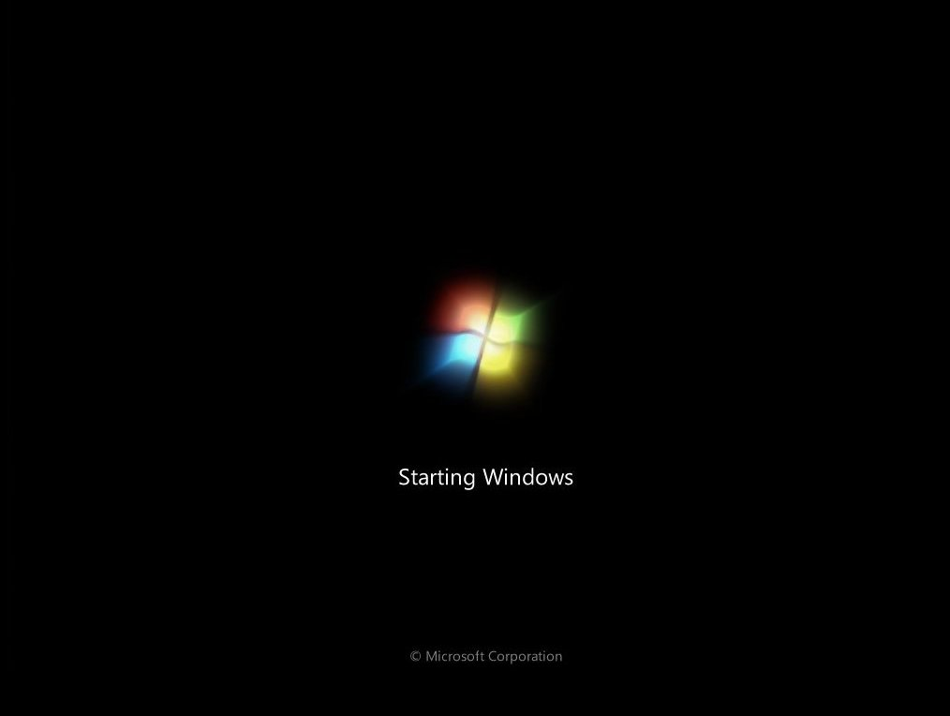
MS Windows Versions

Slide 25
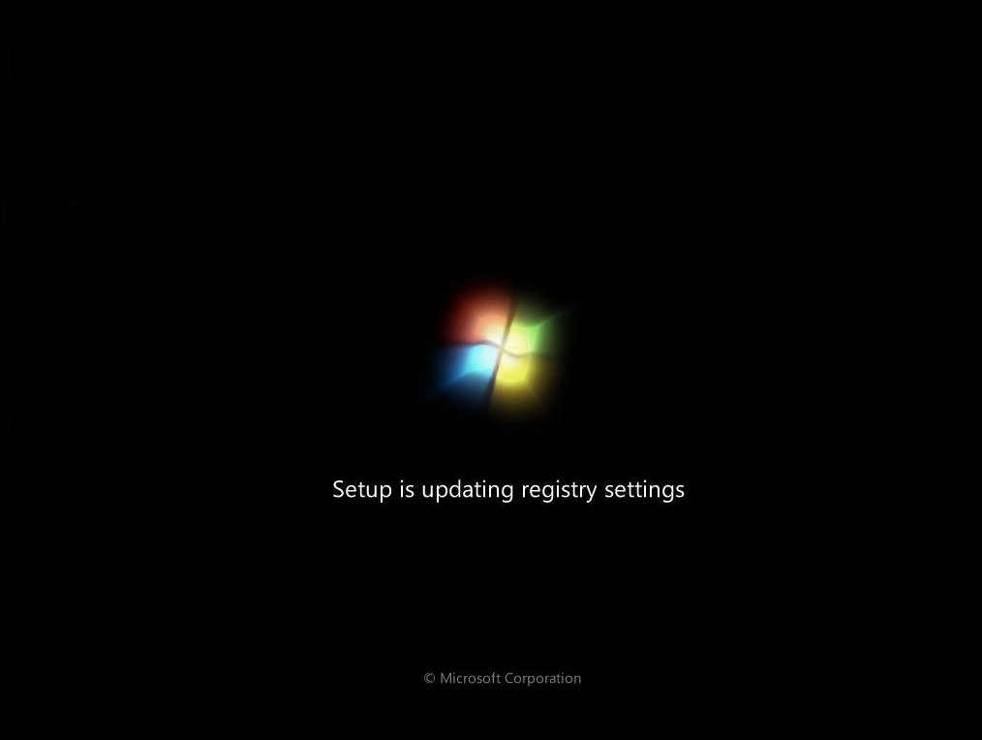
MS Windows Versions

Slide 26
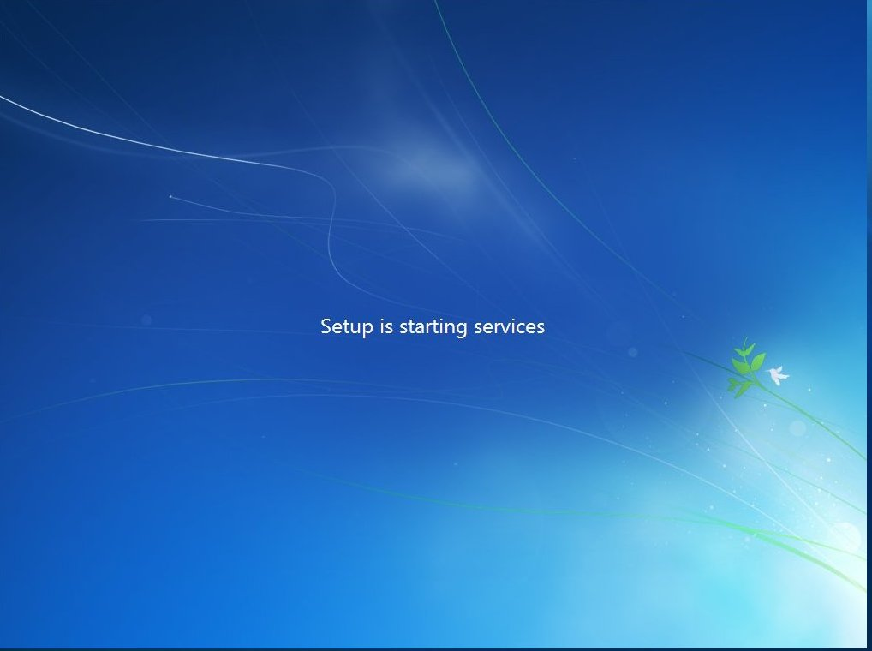
MS Windows Versions

Slide 27
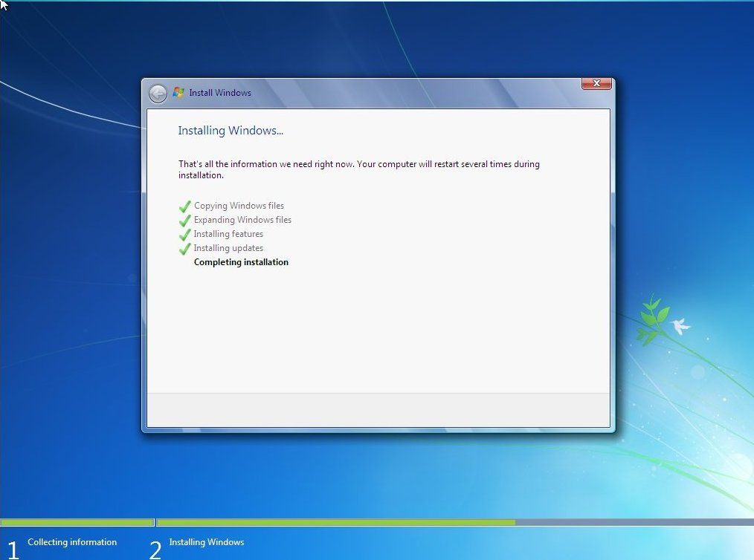
MS Windows Versions
After restarting for the first time, it will continue the setup. This is the last step so it will take the most time than the previous steps.

Slide 28
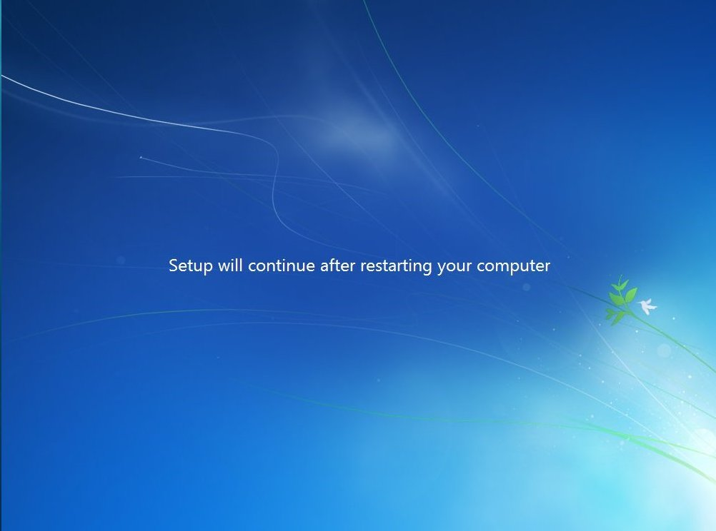
MS Windows Versions

Slide 29
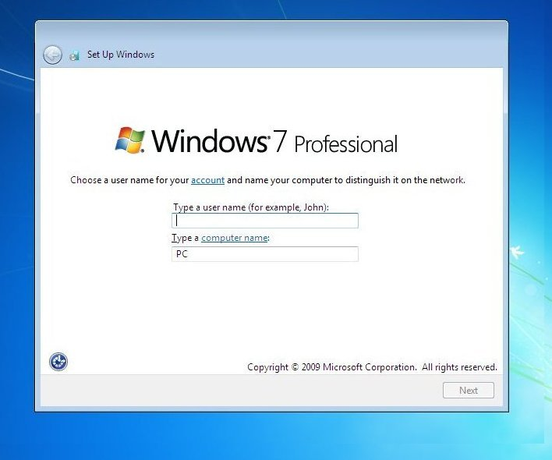
MS Windows Versions
Type your desired user name in the text-box and click Next. It will automatically fill up the computer name.

Slide 30
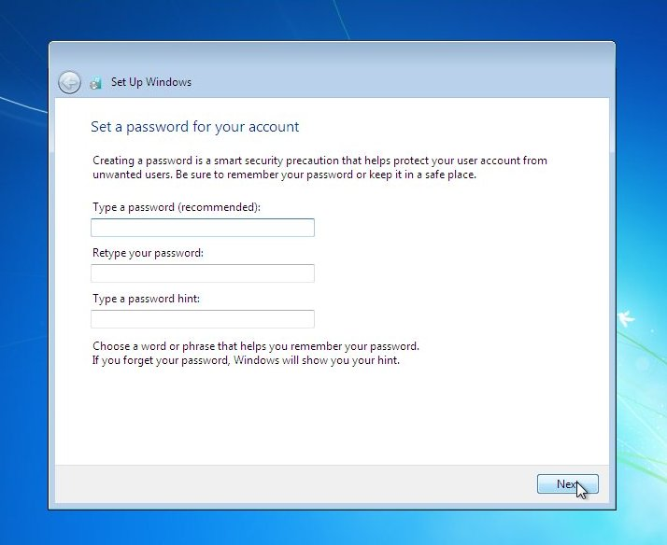
MS Windows Versions
If you want to set a password, type it in the text-boxes and click Next.

Slide 31
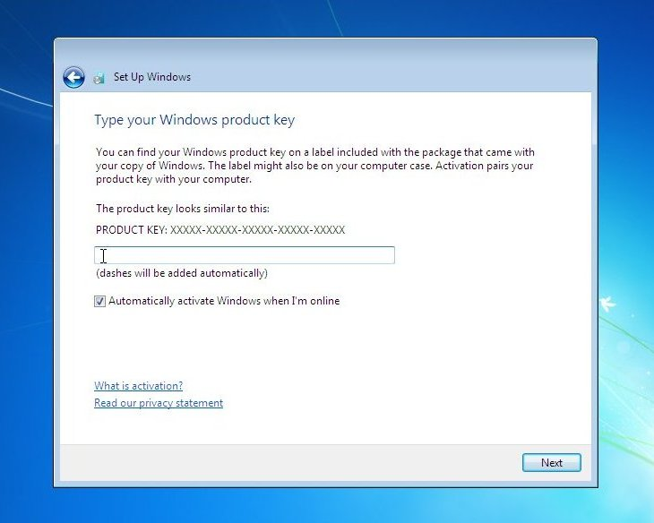
MS Windows Versions
Type your product key in the text-box and click Next. You can also skip this step and simply click Next if you want to type the product key later. Windows will run only for 30 days if you do that.

Slide 32
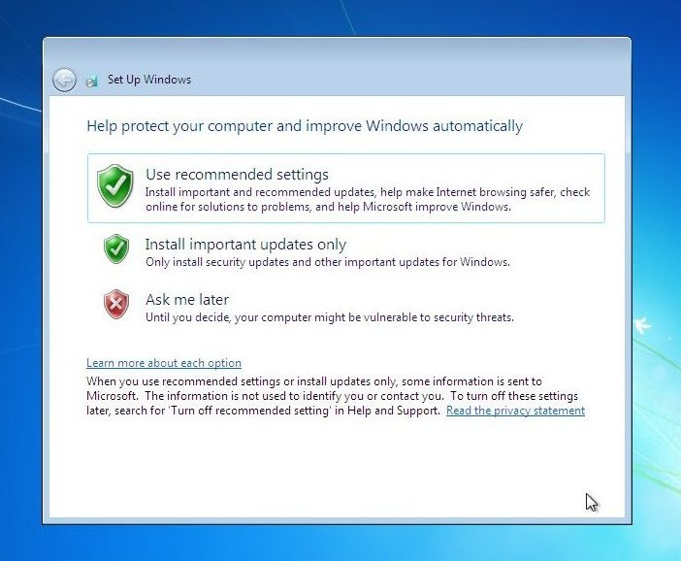
MS Windows Versions
Select your desired option for Windows Updates.

Slide 33
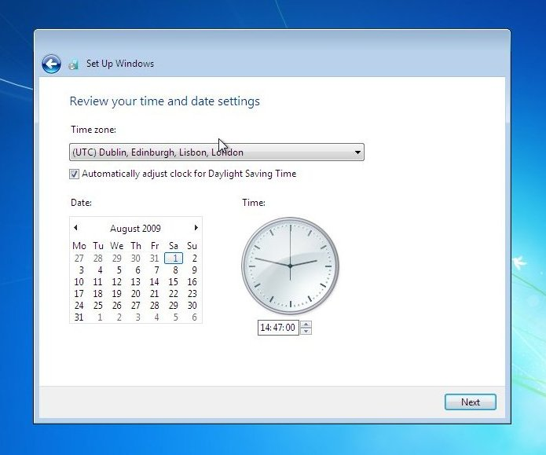
MS Windows Versions
Select your time and click Next.

Slide 34
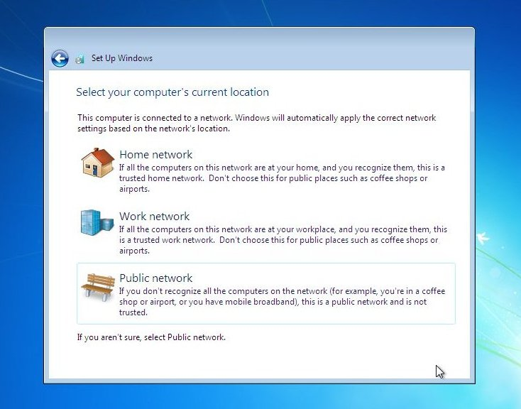
MS Windows Versions
If you are connected to any network, it will ask you to set the network’s location.

Slide 35
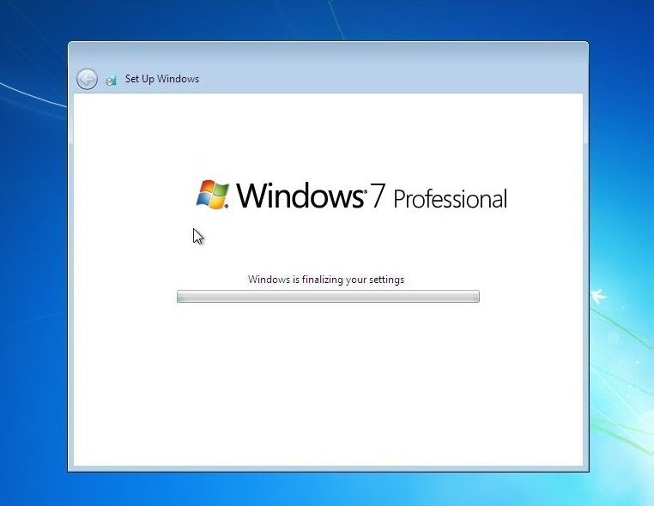
MS Windows Versions
Window is finalizing your settings

Slide 36

MS Windows Versions
Welcome Screen

Slide 37
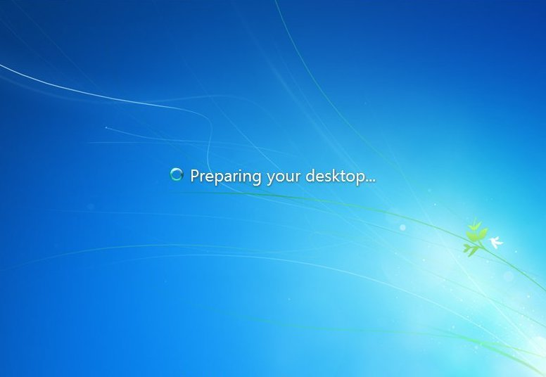
MS Windows Versions
Preparing your desktop

Slide 38
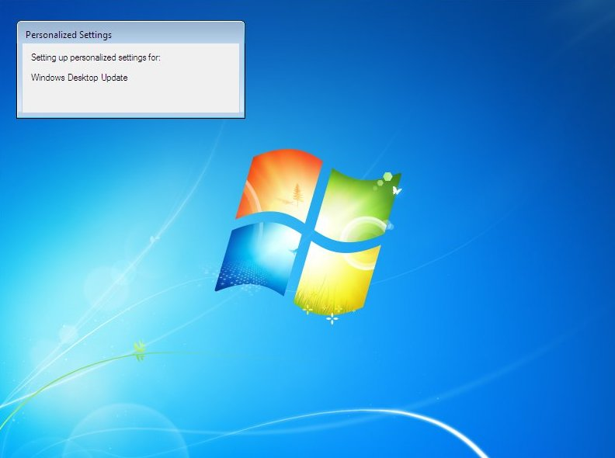
MS Windows Versions
MS Windows Versions

Slide 39
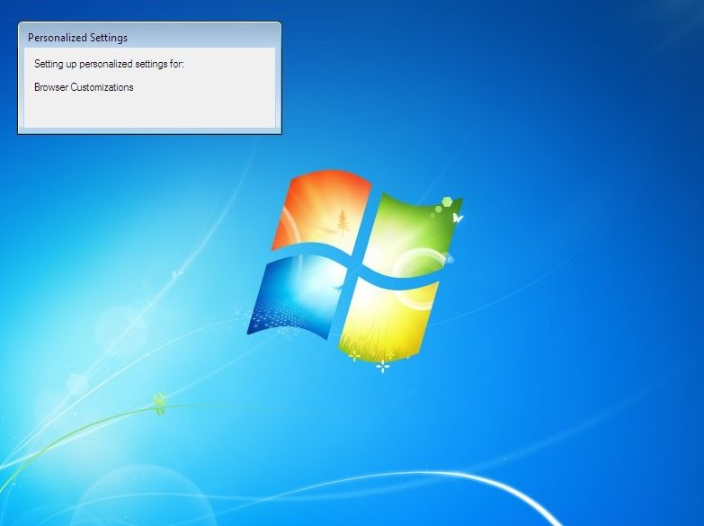
MS Windows Versions

Slide 40
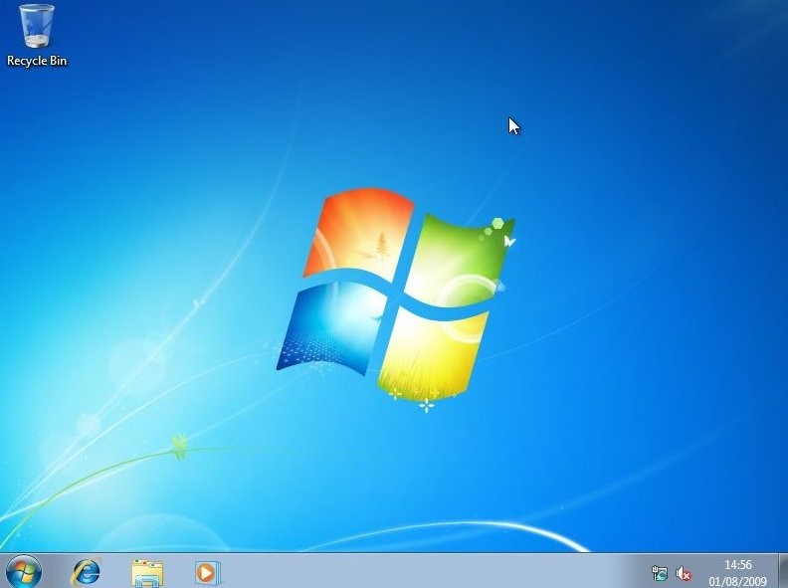
MS Windows Versions
And there you have a fresh copy of Windows 7 installed!

Slide 41
Contact
Email: anuj.bharti@galgotiasuniversity.edu.in
Mobile: +91-7791955115

Slide 42


